Slide 1
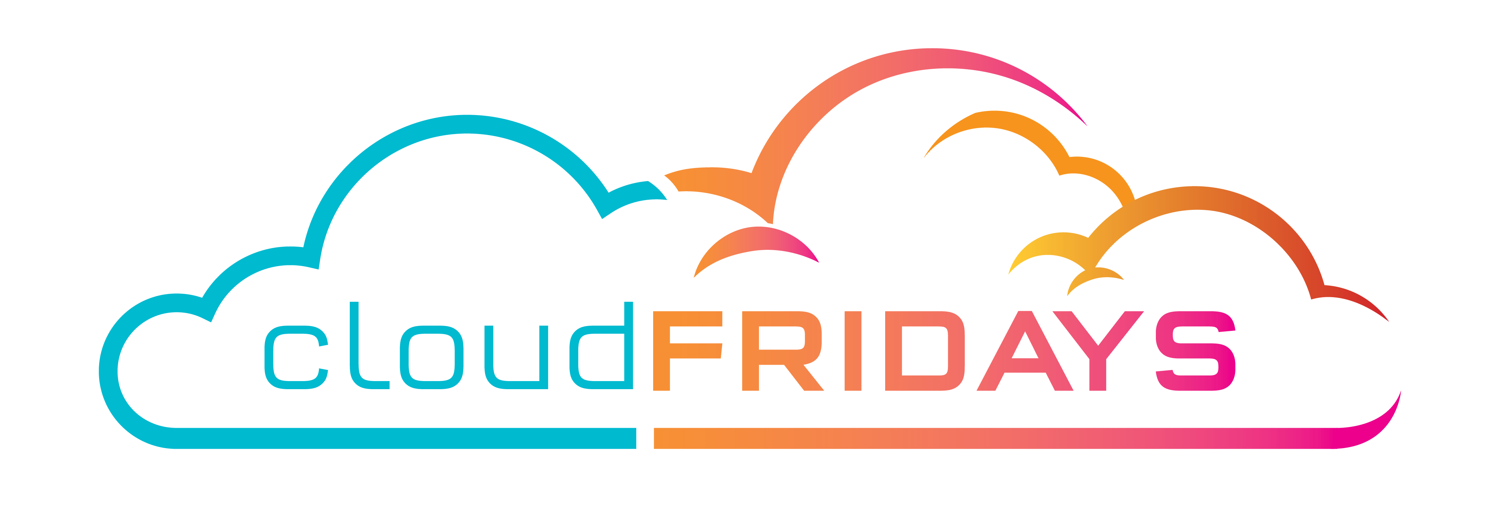

Azure Governance and Management
Warren du Toit / Jody Roberts

Slide 2
Acceleration
Velocity
Speed
Notes:
Accelerate. Speed. Velocity. Businesses need to be agile. They need to quickly adopt to new business trends or else they are behind the game. What does everyone do? They start running…
With cloud technologies bursting everywhere, it’s quick and easy to deploy. In a matter of minutes, you can be up and running BUT it can be dangerous if you don’t have the right plan in place…Accelerating your business to achieve success is a must but often the need to accelerate causes lapses in controls to meet compliance and regulation standards.

Slide 3
Move fast and break things is fantastic …

Slide 4
… until the thing you break is your neck!

Slide 5
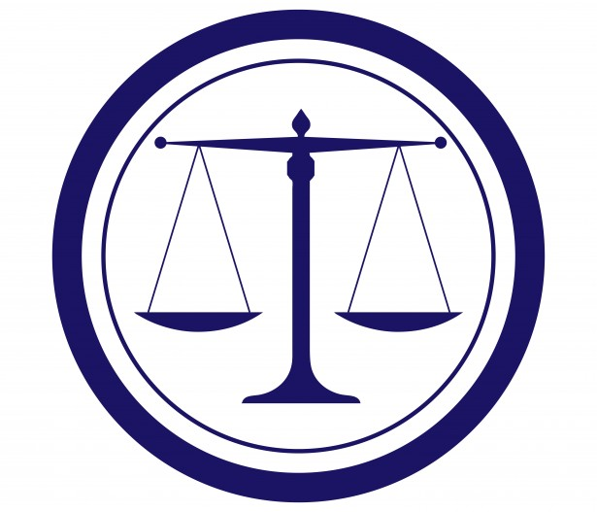
Technical Governance
Cost Management
Security Baseline
Resource Consistency
Identity Baseline
Deployment Acceleration
Notes:
Governance Is about applying internal controls and measurements. The policies within your organization serve as the early warning system to detect potential problems. The Governance controls are disciplines that help the company mitigate risks and create guardrails. There 5 disciplines when we think about cloud governance which are:
Cost Management
Security Baseline
Resource Consistency
Identity Baseline
Deployment Acceleration

Slide 6


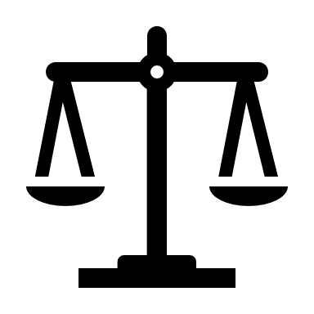

Tailwind Traders' Cloud Governance Challenges
Lack of visibility of environment due to cloud sprawl
Accidental deletions
PCI-DSS compliance concerns
Governance at scale - Standards and Enforcement of control of a rapidly growing environment

Slide 7
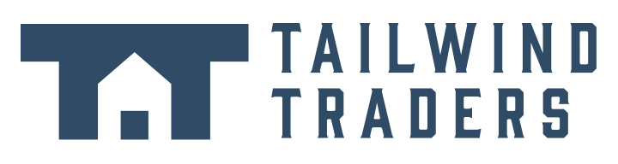

Tailwind Traders has multiple teams in multiple locations working across multiple subscriptions.
Notes:
TT is concerned that deployments are occurring in an ad hoc manner that is primarily driven by whatever whims an operator has at deployment time. Some deployments violate the organization's compliance obligations, such as being deployed in an unencrypted manner without DR protection. After brining their existing IaaS VM fleet under control (MCO-10) TT wants to ensure that current and future deployments are compliant with policy and organizational requirements.

Slide 8
No single person or team knows the details of every workload that is deployed.
Notes:
TT is concerned that deployments are occurring in an ad hoc manner that is primarily driven by whatever whims an operator has at deployment time. Some deployments violate the organization's compliance obligations, such as being deployed in an unencrypted manner without DR protection. After brining their existing IaaS VM fleet under control (MCO-10) TT wants to ensure that current and future deployments are compliant with policy and organizational requirements.

Slide 9
How does Tailwind Traders get visibility into their complex cloud deployment?

Slide 10
Demo: Azure Resource Graph

Slide 11

Azure Resource Graph
Ensure compliance
1
2
Empower DevOps
3
Manage costs
Get visibility into your resources for effective inventory management
Explore your resources
Query & analyze
Assess impact
Get visibility into your Azure resources across subscriptions and management groups.
Access the information you need in the portal, CLI or PowerShell
Find assets based on resource properties or their relationships
Get the exact information you need through queries in seconds
Perform analysis at scale across all your environments
Leverage Keyword Query Language for easy query creation
Understand the impact of applying policies before their implementation
Get a view of the operational impact of common actions like deprecations

Slide 12
A junior admin, tasked with saving money, deleted a VM that appeared to have minimal utilization in the last 2 weeks …
Notes:
TT is concerned that deployments are occurring in an ad hoc manner that is primarily driven by whatever whims an operator has at deployment time. Some deployments violate the organization's compliance obligations, such as being deployed in an unencrypted manner without DR protection. After brining their existing IaaS VM fleet under control (MCO-10) TT wants to ensure that current and future deployments are compliant with policy and organizational requirements.

Slide 13
… it was only used to perform end of month to perform complex reconciliation of the organization’s global accounts
Notes:
TT is concerned that deployments are occurring in an ad hoc manner that is primarily driven by whatever whims an operator has at deployment time. Some deployments violate the organization's compliance obligations, such as being deployed in an unencrypted manner without DR protection. After brining their existing IaaS VM fleet under control (MCO-10) TT wants to ensure that current and future deployments are compliant with policy and organizational requirements.

Slide 14
How does Tailwind Traders prevent accidental changes and allow Ops to understand which resources should not be deleted?

Slide 15
Demo: Locks and Tags

Slide 16
Azure Resource Locks
All resources within that scope inherit the same lock
You can set lock to 2 settings:
CanNotDelete means authorized users can still read and modify a resource, but they can't delete the resource.
ReadOnly means authorized users can view a resource, but they can't delete or update the resource.
Notes:
Applying ReadOnly Applying this lock is similar to restricting all authorized users to the permissions granted by the Reader role.

Slide 17
Azure Tagging
Metadata assigned to Azure resources
Allows you to organize those resources into a taxonomy
Includes a tag and a value
Allows you to view resources based on tag and value
Notes:
Learn more about tags at: https://docs.microsoft.com/en-us/azure/azure-resource-manager/resource-group-using-tags

Slide 18
How does Tailwind Traders ensure that all resources in a resource group have the appropriate tag?

Slide 19
Demo: Tagging Policy & Remediation

Slide 20
Azure Policies
Policy: A rule that will be enforced
Initiative: A collection of policies
Assignment: The scope where the policy applies
Notes:
https://docs.microsoft.com/en-us/azure/governance/policy/overview

Slide 21

Azure Policy
Ensure compliance
1
2
Empower DevOps
3
Manage costs
Active control and governance at scale for your Azure resources
Enforcement & compliance
Apply policies at scale
Remediate & automate
Turn on built-in policies or build custom ones for all resource types
Real-time policy evaluation and enforcement
Periodic & on-demand compliance evaluation
Policy integration for AKS (NEW)
Apply policies to a Management Group with control across your entire organization
Apply multiple policies and & aggregate policy states with policy initiatives
Exclusion Scope
Policy as Code with Azure DevOps
Remediate existing resources at scale (NEW)
Automatic remediation resources at deployment time
Trigger alerts when a resource is out of compliance
Notes:
Use Policy to audit PCI compliance and remediate issue. Use the PCI Initiative. Also create a custom Initiative for tagging of critical data as DO NOT DELETE

Slide 22
Azure Policy repository
https://github.com/Azure/azure-policy/
Notes:
Tailwind Traders wants to manage resource tags and cost with Azure policy.
Assign pre-created policy from the Azure portal
Create and assign a custom policy with automation tools
Create and assign a policy initiative

Slide 23
How does Tailwind Traders assess PCI-DSS compliance on migrated resources?
Notes:
The Payment Card Industry Data Security Standard (PCI DSS) is an information security standard for organizations that handle branded credit cards from the major card schemes.
The PCI Standard is mandated by the card brands but administered by the Payment Card Industry Security Standards Council. The standard was created to increase controls around cardholder data to reduce credit card fraud. Validation of compliance is performed annually or quarterly,^{[1]} either by an external Qualified Security Assessor (QSA) or by a firm specific Internal Security Assessor (ISA) that creates a Report on Compliance for organizations handling large volumes of transactions, or by Self-Assessment Questionnaire (SAQ) for companies handling smaller volumes. (Source – Wikipedia)
https://en.wikipedia.org/wiki/Payment_Card_Industry_Data_Security_Standard

Slide 24
Demo: Audit PCI-DSS compliance

Slide 25
How does Tailwind Traders ensure that new subscriptions and resources deployed to those subscriptions align with PCI-DSS?

Slide 26
Demo: PCI-DSS Azure Blueprints

Slide 27

Azure Blueprints
Ensure compliance
1
2
Empower DevOps
3
Manage costs
Enabling quick, repeatable creation of fully governed environments
Streamline environment creation
Enable compliant development
Lock foundational resources
Centralize environment creation through templates
Add resources, policies and role access controls
Track blueprint updates through versioning
Empower developers to create fully governed environments through self-service
Create multiple dev-ready environments and subscriptions from a centralize location
Leverage the integration with Azure Policy on the DevOps lifecycle
Ensure foundational resources cannot be changed by subscription owners
Manage locks through a centralize location
Update locked resource through blueprint definition updates
Notes:
Review Blueprint technology- talk about builtin blueprint

Slide 28

How it works
ARM Templates
Policy Definitions
Contoso Blueprint
2
Secure foundational resources
Role-based access controls
Subscription A
Cloud Engineer
Subscription B
1
Custom Scripts*
Create a Blueprint definition and add artifacts
Subscription C
3
…
Stamp out environments
Cloud Architect
ISO 27001
Coming in June
4
Version and Update Blueprints
PCI-DSS
+
NIST
…
5
Built-in Blueprints

Slide 29
Blueprint Locks
Don’t Lock means resources are not protected by Blueprints.
Do Not Delete means that the resources can be altered, but can’t be removed. Can’t be removed by sub owner.
Read Only (Resource Group) means that tags on the resource group can’t be altered. Not Locked resources can be added, moved, changed or deleted from the RG. Can’t be removed by sub owner.
Read Only (Non Resource Group) means that the resource created by the Blueprint (policies and so on) cannot be modified in any way and cannot be deleted. Can’t be removed by sub owner..

Slide 30
Blueprints related to regulation
Compliance Framework | Blueprints
AU PROTECTED | IaaS web application PaaS web application
FEDRAMP | Data analytics Data warehouse IaaS web application PaaS web application
FFIEC | Data analytics Data warehouse IaaS web application PaaS web application

Slide 31
Existing Blueprints related to regulation
Compliance Framework | Blueprints
HIPPA/HITRUST | Health Data and AI
NIST SP 800-171 | Data analytics Data warehouse IaaS web application PaaS web application
PCI DSS | Data analytics Data warehouse IaaS web application PaaS web application

Slide 32
Recap—TT solved the following Cloud Governance challenges:
Lack of visibility of environment due to cloud sprawl
Accidental deletions
PCI-DSS compliance concerns
Governance at scale - Standards and Enforcement of control of a rapidly growing environment

Slide 33
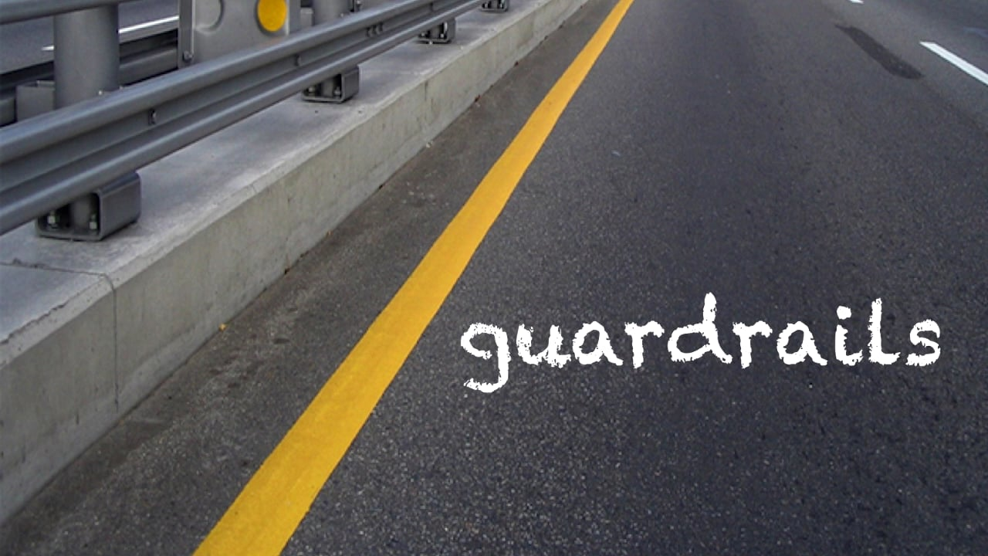
This Photo by Unknown Author is licensed under CC BY-NC-ND
Notes:
Today you learned how Tailwind Traders solved the following governance challenges. You saw that they used guardrails. Guardrails to give them speed & control over their environment.

Slide 34





Speed and control
Cloud-native governance: Removing barriers to compliance and enabling velocity
Management Groups
Management
Groups
Cost Management
Developers
Cost
Management
Resource
Graph
Cloud Custodian Team
Operations
Policy
Blueprints
Templates
RBAC
Policies
Notes:
Using the guardrails TT got governance. The checks and balances. Measurements and controls needed to stay compliant in their business yet still enabling the business and developers to operate without roadblocks

Slide 35
Thank You!

